Slide 1
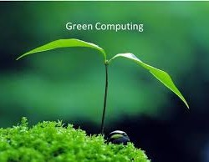
MINIMIZING POWER USAGE IN GREEN COMPUTING
01
A project presented by Group2

Slide 2
Group 2 Members
FYIT
Shaikh Sajeed Ali
83
Omkar Narkar
52
Adeen Shaikh
79
Harsh Ghadigaonkar
13
Shubham Waghe
102
Hemang Thaker
93
02
Noorjahan Pinjari
63

Slide 3
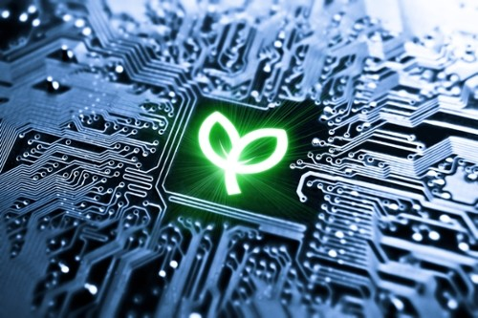
ABSTRACT:
Green computing or green IT, refers to environmental sustainable computing or IT. It
is "the study and practice of designing, manufacturing, using and disposing of computers, servers and associated subsystems- such as monitors, storage devices and networking and communications systems effectively and efficiently with minimal or no impact on environment.
03

Slide 4


Benefits of Green Computing:
Reduce Hazardous material usage
Maximize energy efficiency Promote recyclability Device efficient disposal methods
Reduce carbon footprint Reduce GHG emmisions Save money due to reduced utility cost
04

Slide 5
Power Management
The Avanced Configuration and Power Interface (ACPI), an open industry standard, allows an operating system to directly control the power saving aspects of its uderlying hardware. This allows system to automatically turn off components such as monitors and hard drives after set periods of inactivity.
05

Slide 6
Desktop computer power supplies (PSUs) are generally 70-75% effecient, dissipating the remaining energy as heat.
Power Supply:
An industry initiative called 80 plus certifies PDUs that are at least 80% effecient; typically these models are drop-in replacements for order, less efficient PSUs of the same form factor.
06
As of July 20 2007, all new Energy Star 4.0certified desktop PSUs must be atleast 80% efficient.

Slide 7
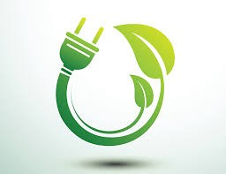


Power Savings Opportunities:
Following areas where the authors felt that there is the scope of optimising the usage of power:
07
I/O devices Storage Units Processors Operating systems

Slide 8
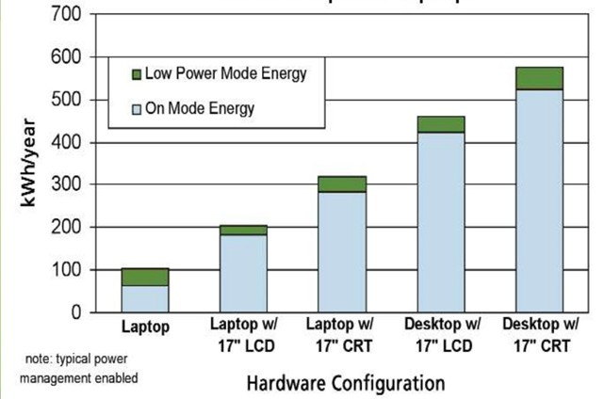
Energy Consumption for Desktop and Laptop:
08

Slide 9
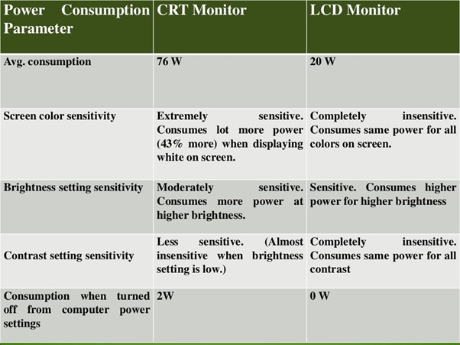
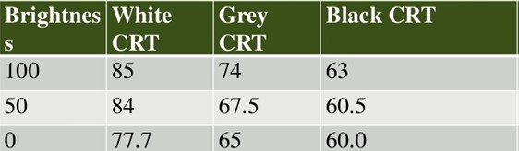
Display:
09

Slide 10
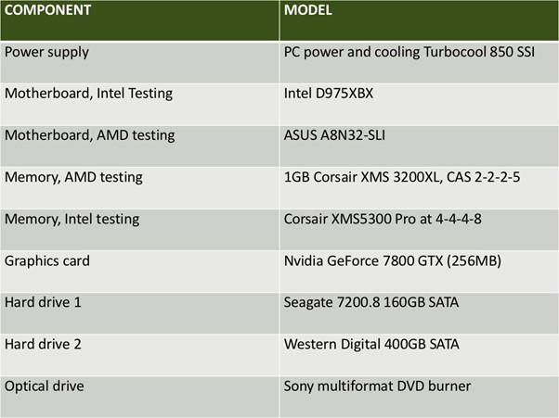
Processor Power Consumption:
Testing power consumption of CPUs is a trickier task than
graphic cards. The difference in power consumption between a CPU at idle and a
10
CPU at full load wasn't as large as with graphic cards.
The system all had the following components:

Slide 11
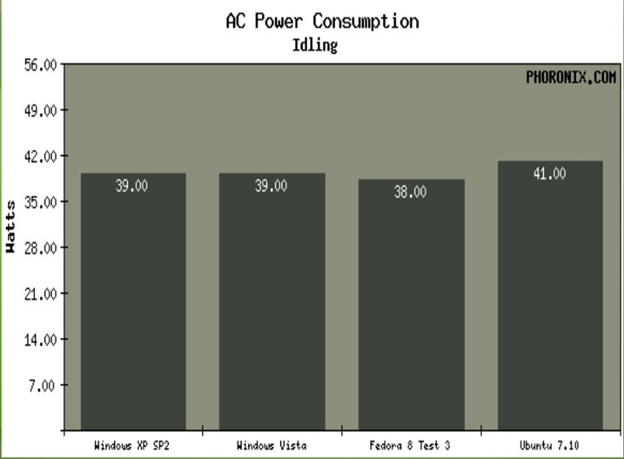
Operating System Issues:
In our "desktop usage" power tests, both Feodra 8 Test 3
and Ubuntu 7.10 had consumed more power than both versions of Microsoft
1 1
Windows Tested. Feodra and Ubuntu were consuming 65 Watts while Windows Xp cnsumed 58 Watts. Granted, this test isn't very controlled and was just intented to give a rough overview.

Slide 12

Top 10 steps to Minimize Power Usage:
Energy star labelled accessories. Sleep mode for unwanted usage. Better turn up switch off to save.
Better be recycling the Electronics.
Indicators for saving electricity.
Screen savers use powers so do not use them.
12
Don't discard your computing devices rather donate or recycle them.
Use hibernate features when not using computers for a short time.
Enable the power management feature.
Use optimal brightness level to consume power.

Slide 13
Advantages and Disadvantages:
Advantages
Sustainable computing means reduced energy consumption that leads to reduced GHG emissions and fossil fuel usage.
Green computing is cost-effective due to less energy usage and cooling
requirements.
Sustainable IT helps in the preservation and effective utilization of natural resources.
Green IT uses non-toxic components
which do not pose any health hazard to the end-users
Sustainable computing inspires people to reduce, reuse and recycle.
Disadvantages
The initial implementation is costly.
Frequent change in technology.
Green IT cause more burden to an individual.
The disparity in the level of understanding across various companies, professionals and end- users.
Fewer courses and publications related to green computing.
13

Slide 14
Conclusion:
It has been observed that the power management can be achieved by controlling the use of the processor through the optimized usage of processor and the display devices through the OS. A little optimization in the discussed area will produce the better power control for domestic and commercial computing devices. The power management has a large scope in the portable devices also as it is the technology of the future.
14

